Slide 1

Ortho eyes
Tim Bekema
Beau Fiechter
Donna van Grunsven
Jasmijn Heupers
Emma Korf
Danny Vink

Slide 2
Table of contents
Ortho Eyes
Research question
Flock of bird system
Or-ensemble
Searching for features
Understanding Euler angles

Slide 3
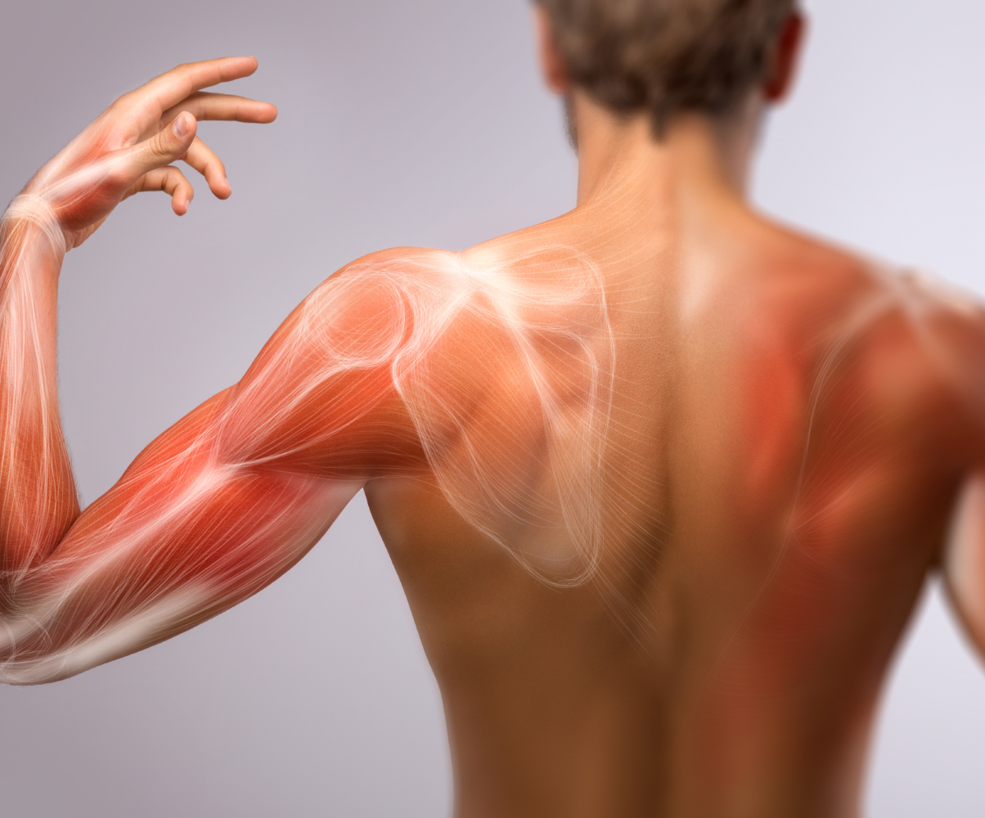
Ortho eyes
Shoulder injury
Identify patients group
Flock of birds system
Different exercises

Slide 4
Research question
Which models can be added to the OR-ensemble to improve the classification of individuals to the correct patient group using the existing data from a Flock of Birds system?

Slide 5
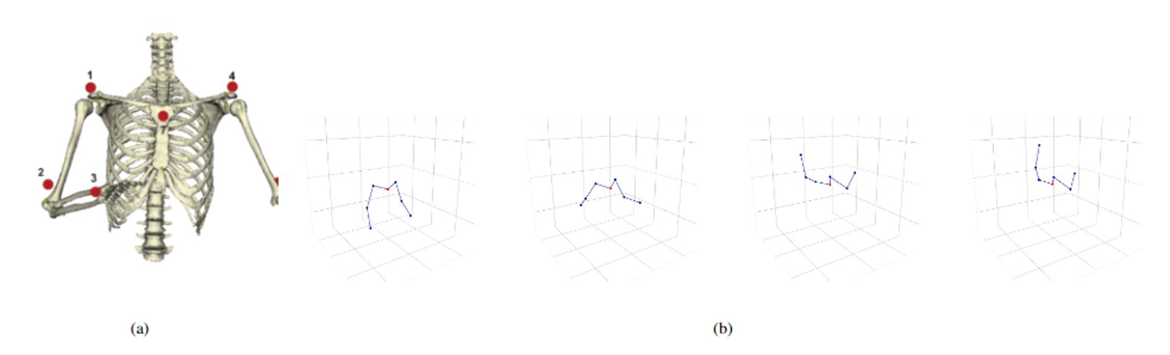
Flock of birds system

Slide 6
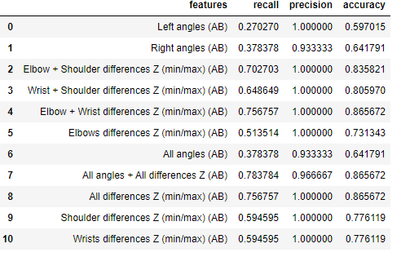
Or-ensemble
Multiple models and features
Models could be seen as different doctors

Slide 7
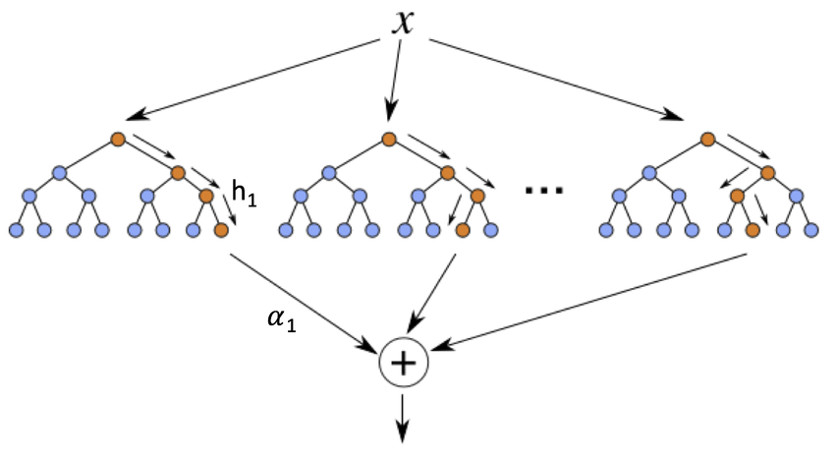
Or-ensemble + decision tree
Plans to create a decision tree filled with the OR-ensemble

Slide 8
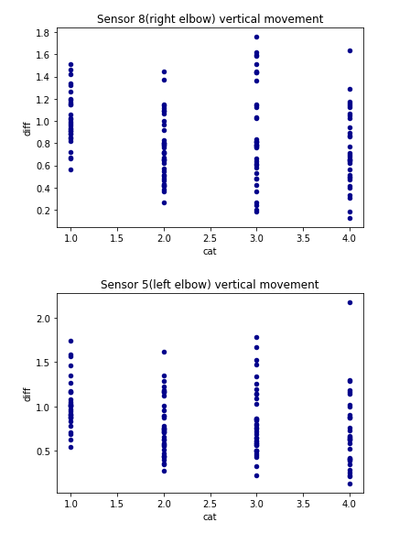
Searching for features
Dissect the different exercises.
Look for deviations in different sensors

Slide 9
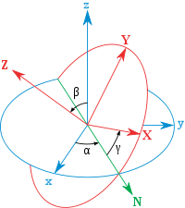
Understanding euler Angles
Used to describe the rotation in space
We try to decipher the Euler angles data

Slide 10
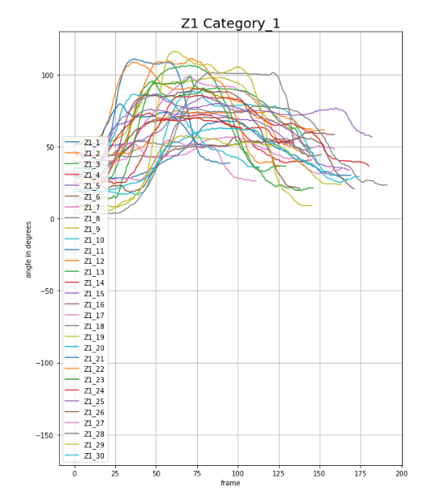
Understanding euler angles
Notes:
Rotation

Slide 11
Any questions?

